Slide 1
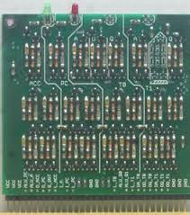
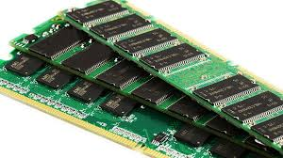
Primary Storage
1. Registers
Part of the CPU
Stores limited amounts of instructions
2. Random Access Memory (RAM)
It holds a software program
Stores only small amount of data

Slide 2
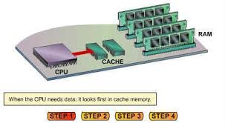
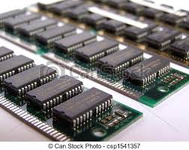
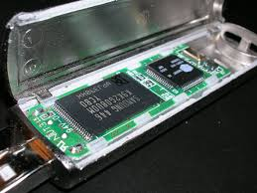
3.Cache Memory
Temporarily store blocks of data used more often
4. Read-Only Memory (ROM)
Critical instructions are safeguarded
Storage is non-volatile
Retains the instructions when the power is off
Flash Memory – Rewritable read only memory that is compact, portable and need less power.

Slide 3
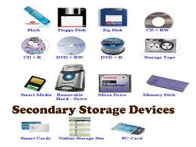
Secondary Storage
Features
It is Non-volatile
Takes more time to retrieve data
Cheaper than primary storage
Take place on variety of media

Slide 4
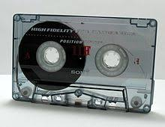
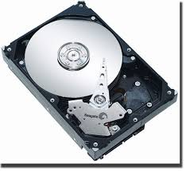
Various forms of Secondary storages
Magnetic Tape
Stored on a large open reel or cartridge or cassette.
Access the data sequentially.
2. Magnetic Disks
Storage on a magnetized disk divided into tracks
Sectors that provide addresses for various pieces of data
Also called Hard Disks

Slide 5
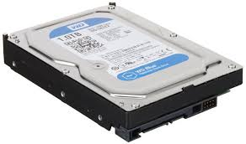
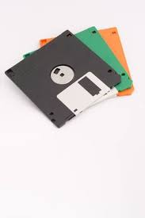
3. Hard Disks
Stores data on platters divided into concentric tracks.
Follow direct access mechanism to read data.
4. Magnetic Diskettes
Easily portable
Stored on Flexible Mylar disks
Also called Floppy Disks

Slide 6
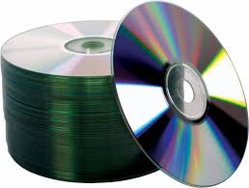
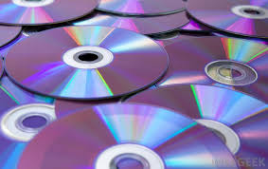
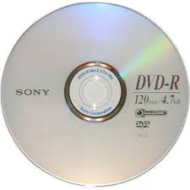
5. Optical Storage Devices
Laser reads the surface of a reflective plastic platter
6. Compact Disk, Read-only Memory(CD-ROM)
Only read and not written on
7. Digital Versatile Disk(DVD)
Store digital video or computer data

Slide 7
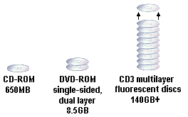
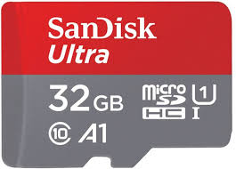
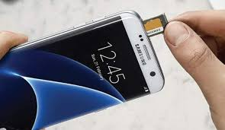
8. Fluorescent Multilayer Disk(FMD-ROM)
Storage capacity is much greater than DVDs
9. Memory Cards
Installed in an adapter or in many personal computers.
10. Expandable Storage Devices
Removable Disk cartridges used as backup storage for internal hard drives of PCs

Slide 8
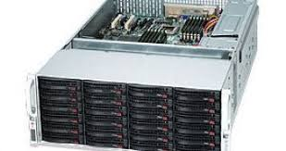
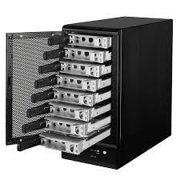
11. Enterprise Storage System
Includes two or more storage devices
12. Redundant Arrays of Independent Disks (RAID)
It is an enterprise storage system that links groups of standard hard drives to a specialized microcontroller that coordinates the drives so they appear as a single local drive

Slide 9
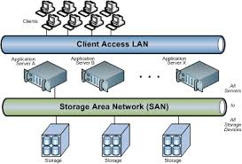
13. Storage Area Network(SAN)
An enterprise storage system architecture for building special, dedicated networks that allow rapid and reliable access to storage devices by multiple servers
14. Storage over IP
Transport stored data between devices within a SAN
Also called IP over Small Computer System Interface(SCSI) or Internet Small Computer Systems Interface (ISCSI)

